Slide 1

Designing the Power Train of TAMUQ Formula Hybrid in Progress Vehicle
Presented by:
Mahmudul Alam, Project Lead
Jaber Al-Marri

Slide 2
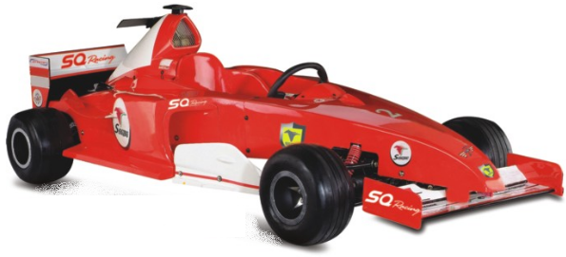

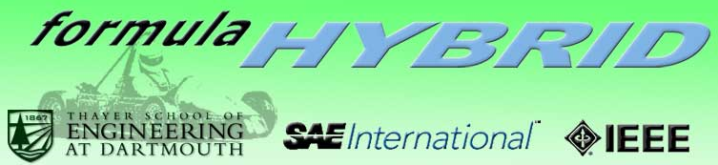
How it all Started

Slide 3
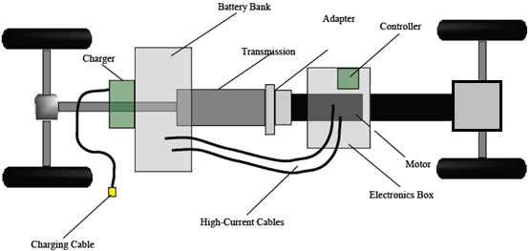
How it all Started
Energy Source Unit
Controller
MOTOR
NEED STATEMENT
“Design, simulate, build, and test a prototype power train of the HIPV that is capable to propel the car by means of a traction motor powered from its onboard batteries. The power train should meet the minimum performance requirements and abide by all the rules and regulations stipulated in the contest rule book.”

Slide 4
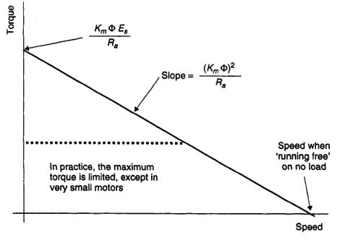
Traction Motor Sizing
Permanent Magnet DC Motor
Benefits
  No external field circuit
  Smaller in size
  High starting torque
  No inverter circuitry
  Easy Control
Disadvantages
  Low Torque Inducement
  Armature Reaction Effect

Slide 5
Traction Motor Sizing
Power Required for initial acceleration
Power Required constant velocity cruising
Differential Equation

Slide 6
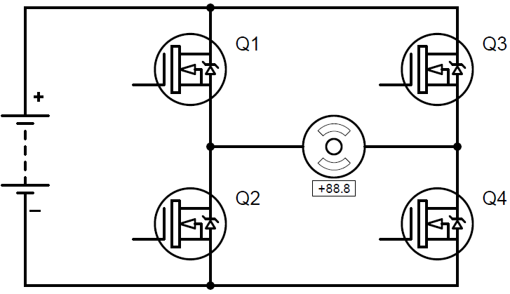
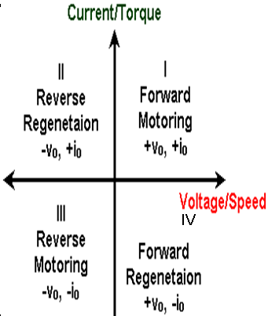
Power Stage Circuit
HI
REV
LO
FWD

Slide 7
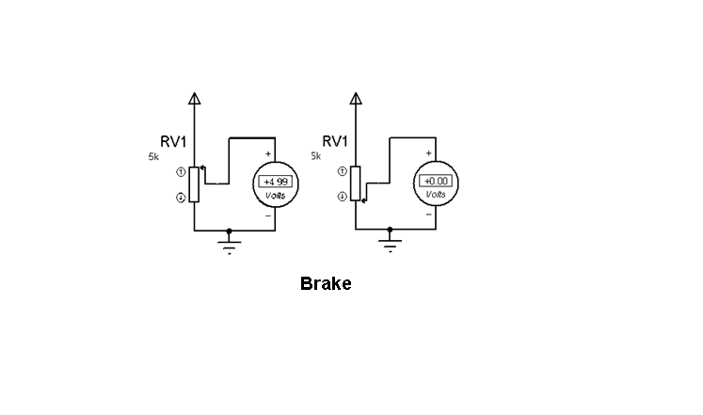
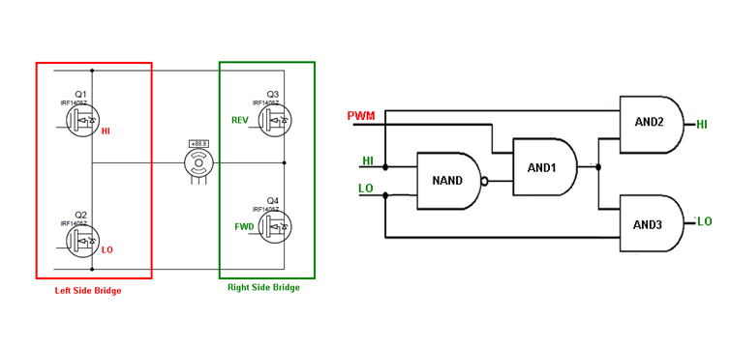
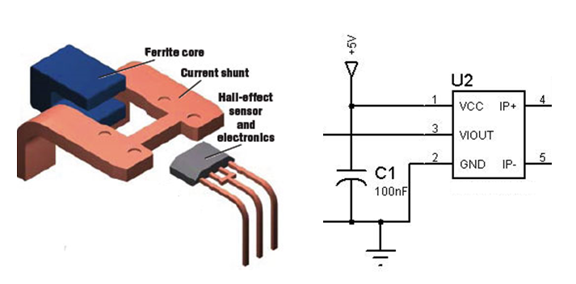
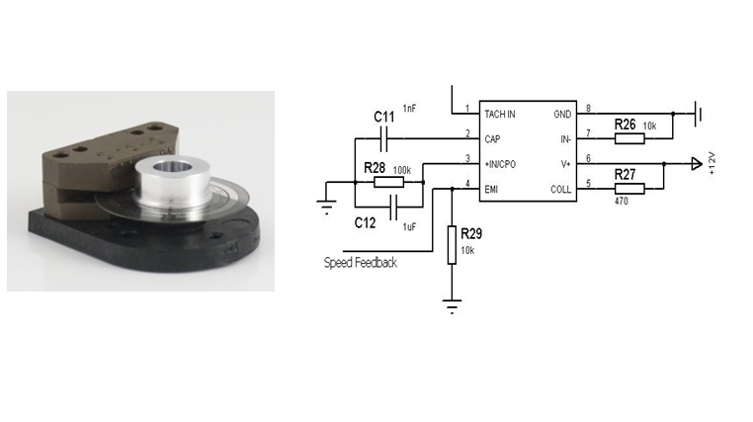
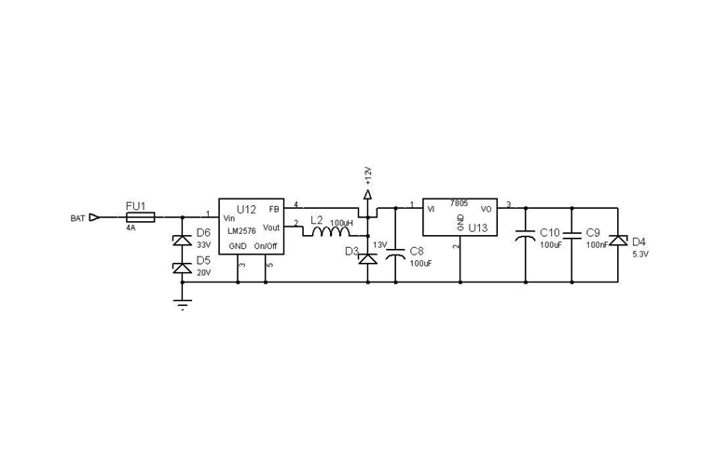
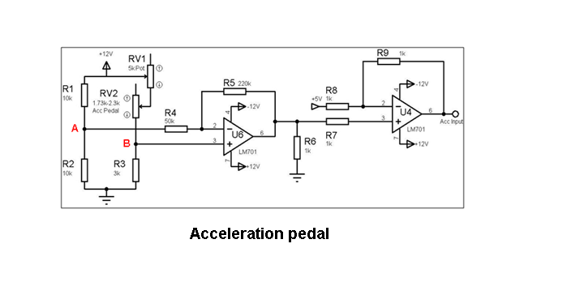
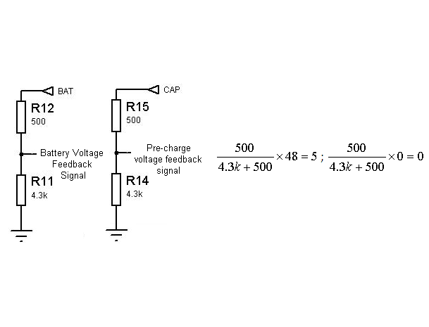
Control Circuit
Power Supply
Accelerator
Brake
F/R Select
Power Stage En
MCU
Logic
Gate Drive
MOSFET
Bridge
LCD
Filter
Power Stage Voltage
Battery Voltage
Current & Speed
Motor

Slide 8
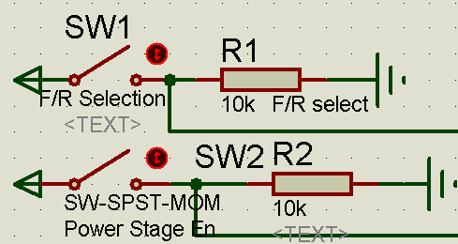
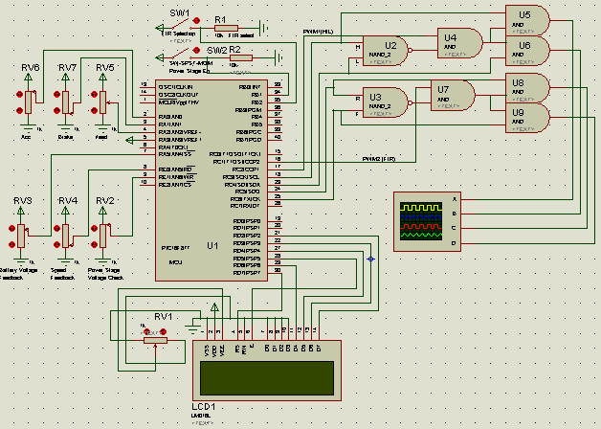
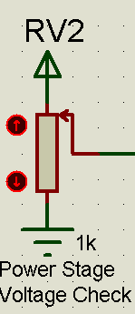
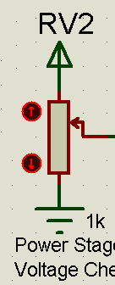
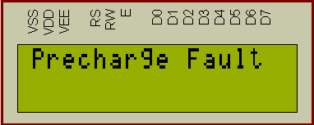
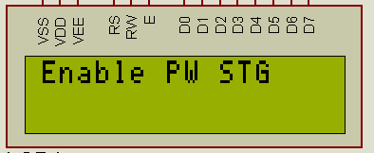
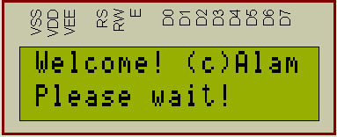
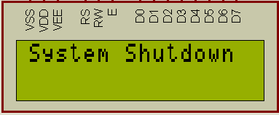
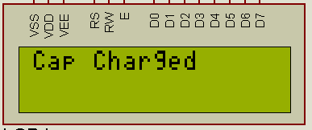
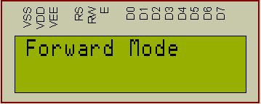
Simulation of Control Circuit

Slide 9
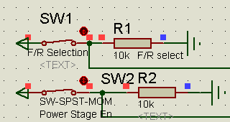
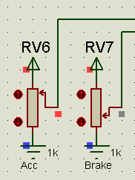
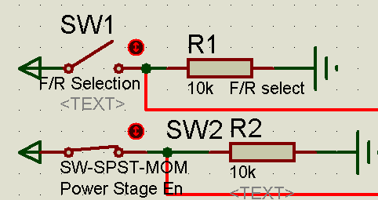
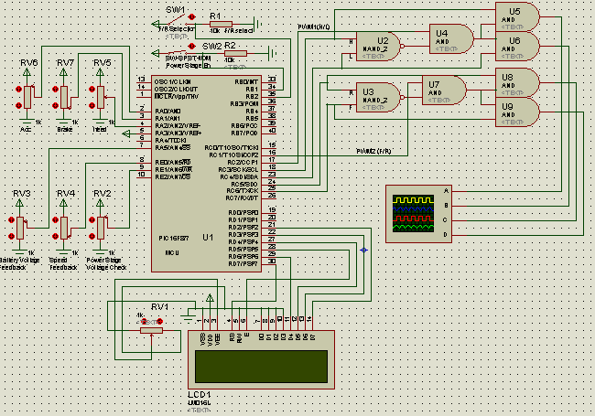
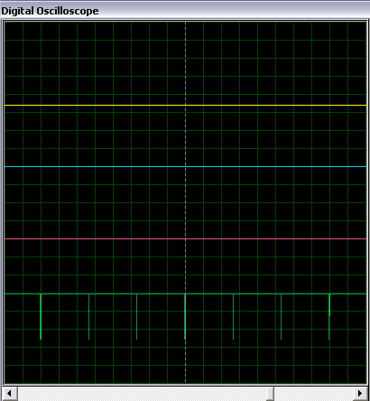
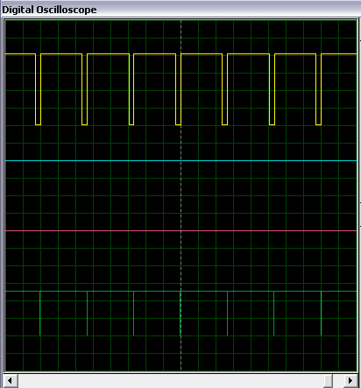
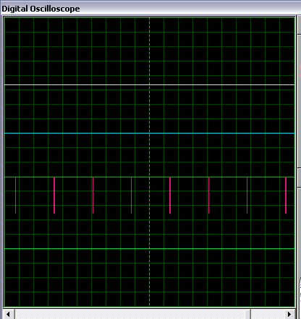
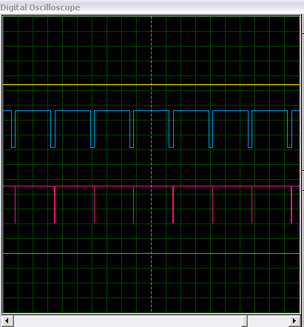
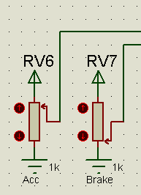
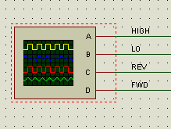
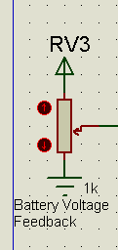
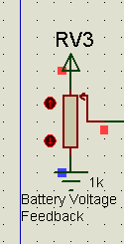
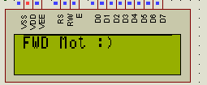
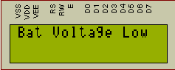
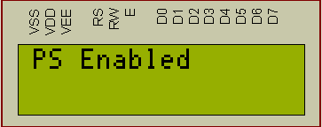
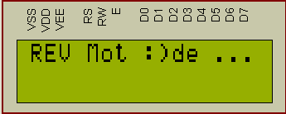
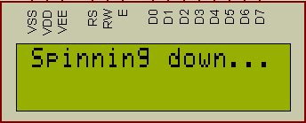
Simulation of Control Circuit

Slide 10
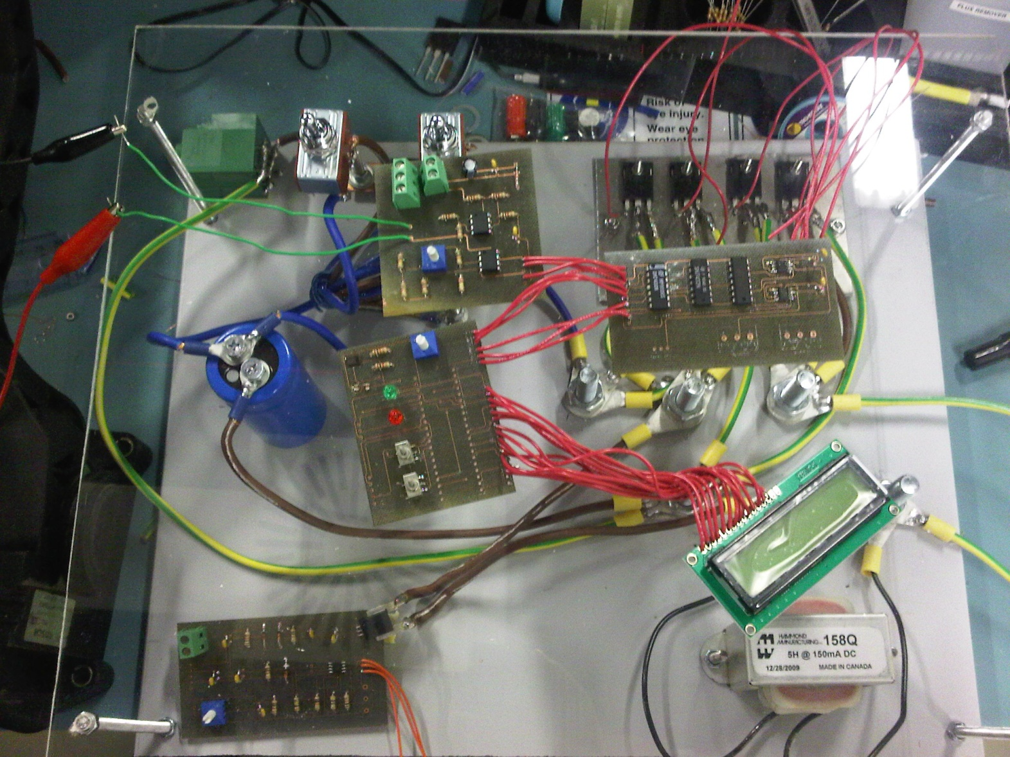
System Implementation

Slide 11
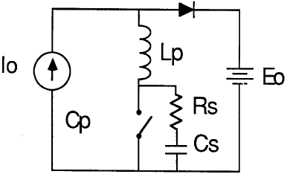
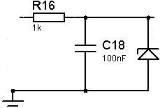
Electromagnetic Compatibility
Susceptible to electrical noise and electro-magnetic interferences (EMI).
Standards
  USA-Federal Communication Standard
  UK-British Standard Institution
  Germany- Verband Deutscher Elektroingenieure

Slide 12
Acknowledgement
Dr. Shehab Ahmed
Dr. Mazen Saghir
Engr. Abdallah Al-Mardawi

Slide 13
Questions
?
THANK YOU

